Slide 1
Risk and Asset Allocation
CH3 Modeling the market
3.1~3.2
0353930黃欣裕

Slide 2
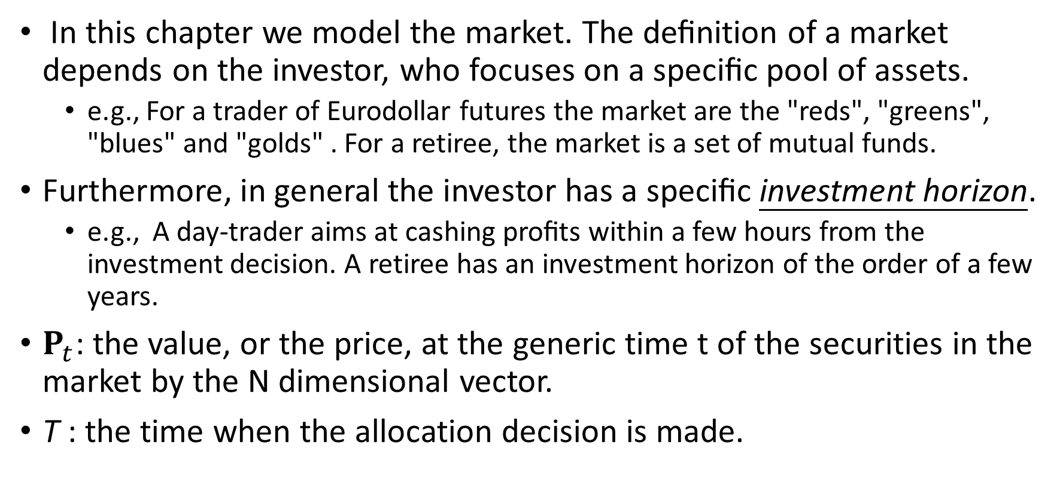
In this chapter we model the market. The deﬁnition of a market depends on the investor, who focuses on a speciﬁc pool of assets.
e.g., For a trader of Eurodollar futures the market are the "reds", "greens", "blues" and "golds" . For a retiree, the market is a set of mutual funds.
Furthermore, in general the investor has a speciﬁc investment horizon.
e.g., A day-trader aims at cashing proﬁts within a few hours from the investment decision. A retiree has an investment horizon of the order of a few years.
$P_{t}$: the value, or the price, at the generic time t of the securities in the market by the N dimensional vector.
T : the time when the allocation decision is made.

Slide 3
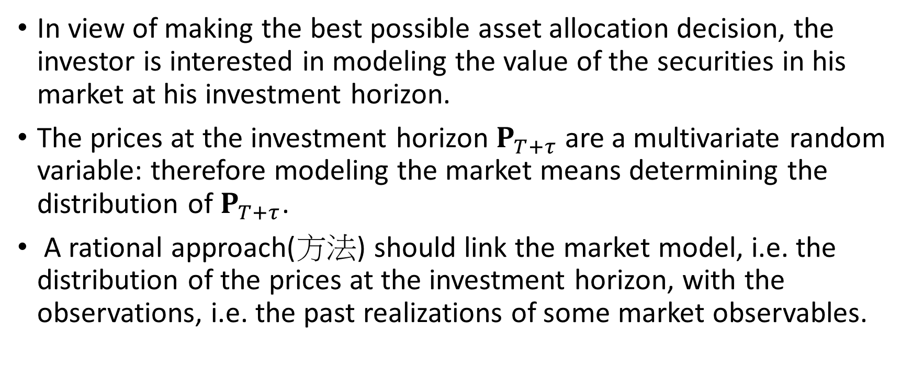
In view of making the best possible asset allocation decision, the investor is interested in modeling the value of the securities in his market at his investment horizon.
The prices at the investment horizon $P_{T+τ}$ are a multivariate random variable: therefore modeling the market means determining the distribution of $P_{T+τ}$.
A rational approach(方法) should link the market model, i.e. the distribution of the prices at the investment horizon, with the observations, i.e. the past realizations of some market observables.

Slide 4
The bridge between past and future consists of four conceptual(概念上) building blocks.
Detecting the invariants
The market displays some phenomena that repeat themselves identically throughout history: we call these phenomena invariants.
The ﬁrst step consists in detecting the invariants, i.e. the market variables that can be modeled as the realization of a set of independent and identically distributed random variables.
For example the weekly returns are invariants for the stock market.
Determining the distribution of the invariants
Due to the repetitive behavior of the market invariants, it is possible by means of statistical procedures to infer their distribution.
e.g., in the stock market the stochastic behavior of the weekly returns can be modeled by a multivariate Student t distribution.

Slide 5
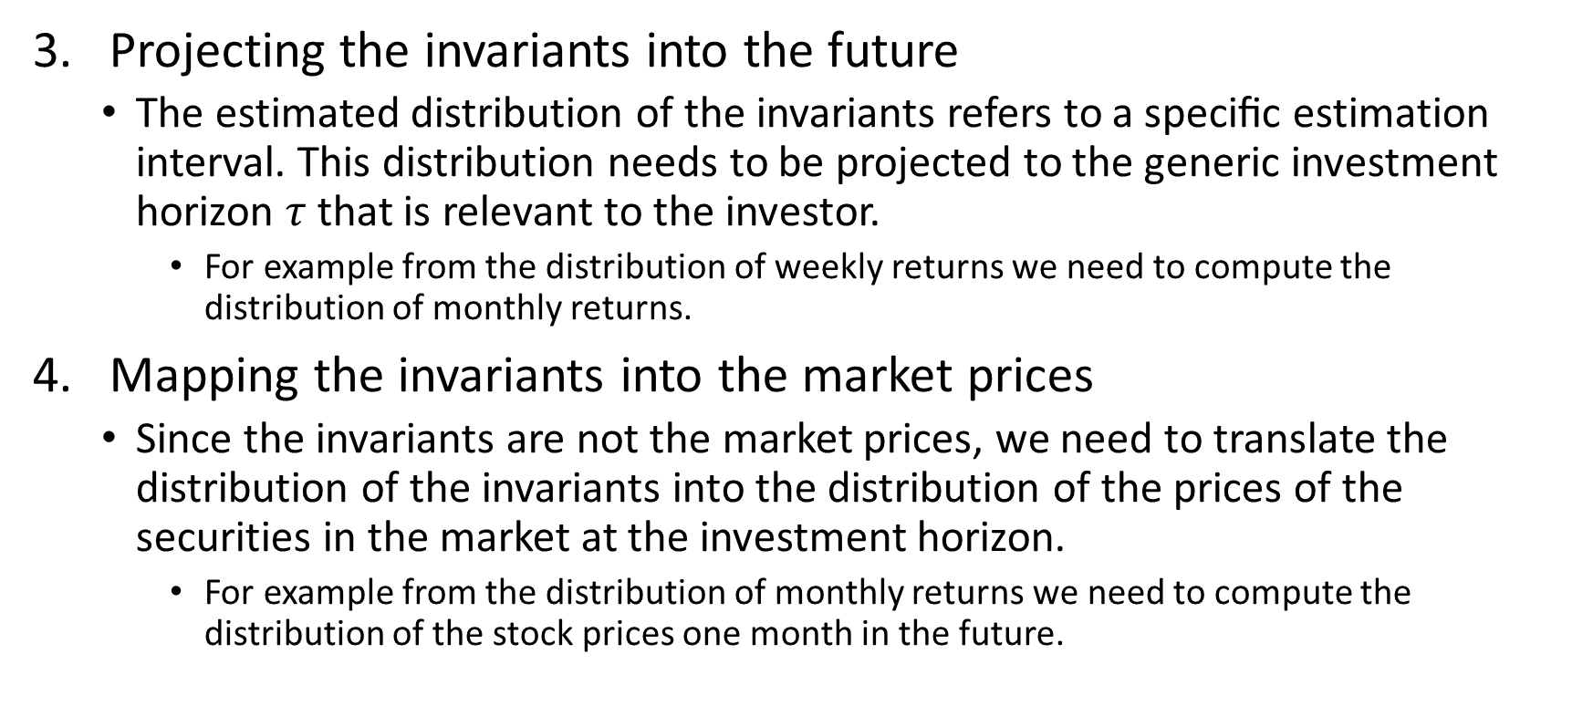
Projecting the invariants into the future
The estimated distribution of the invariants refers to a speciﬁc estimation interval. This distribution needs to be projected to the generic investment horizon $τ$that is relevant to the investor.
For example from the distribution of weekly returns we need to compute the distribution of monthly returns.
Mapping the invariants into the market prices
Since the invariants are not the market prices, we need to translate the distribution of the invariants into the distribution of the prices of the securities in the market at the investment horizon.
For example from the distribution of monthly returns we need to compute the distribution of the stock prices one month in the future.

Slide 6
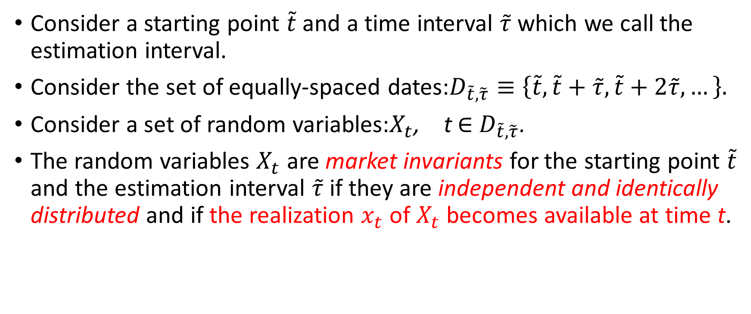
3.1 The quest for invariance
Consider a starting point $\tilde{t}$ and a time interval $\tilde{τ}$ which we call the estimation interval.
Consider the set of equally-spaced dates:$D_{\tilde{t},\tilde{τ}}≡\left\{\tilde{t},\tilde{t}+\tilde{τ},\tilde{t}+2\tilde{τ},…\right\}.$
Consider a set of random variables:$X_{t}$, t$∈$ $D_{\tilde{t},\tilde{τ}}$.
The random variables $X_{t}$ are market invariants for the starting point $\tilde{t}$ and the estimation interval $\tilde{τ}$ if they are independent and identically distributed and if the realization $x_{t}$ of $X_{t}$ becomes available at time t.

Slide 7
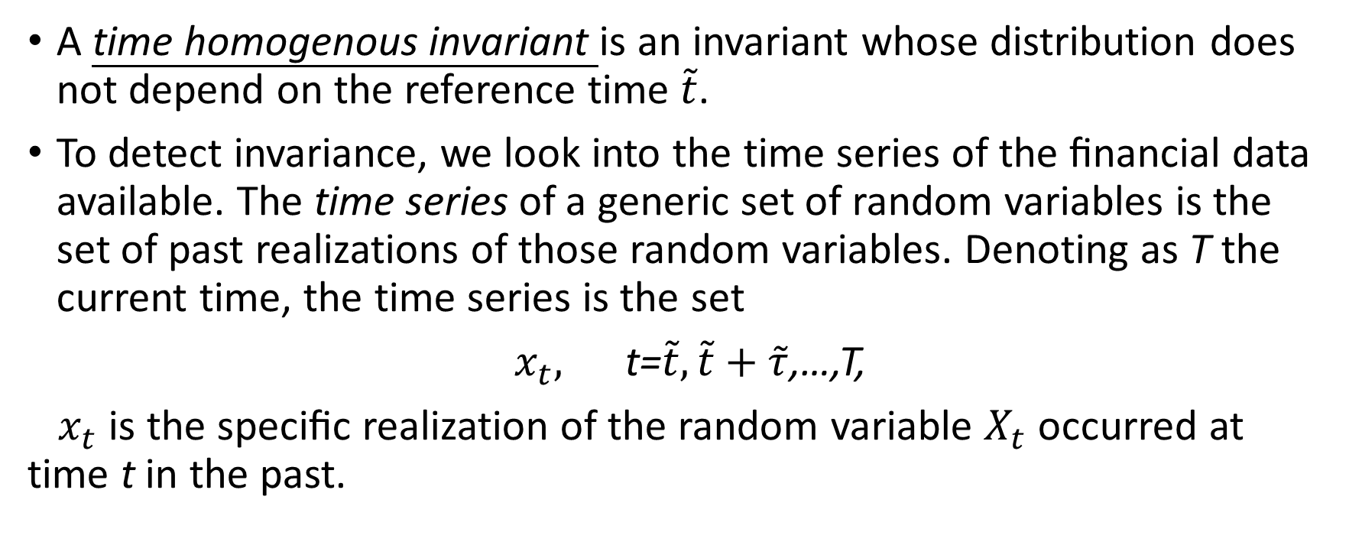
A time homogenous invariant is an invariant whose distribution does not depend on the reference time $\tilde{t}$.
To detect invariance, we look into the time series of the ﬁnancial data available. The time series of a generic set of random variables is the set of past realizations of those random variables. Denoting as T the current time, the time series is the set
$x_{t},$ t=$\tilde{t},\tilde{t}+\tilde{τ}$,…,T,
$x_{t}$ is the speciﬁc realization of the random variable $X_{t}$ occurred at time t in the past.

Slide 8
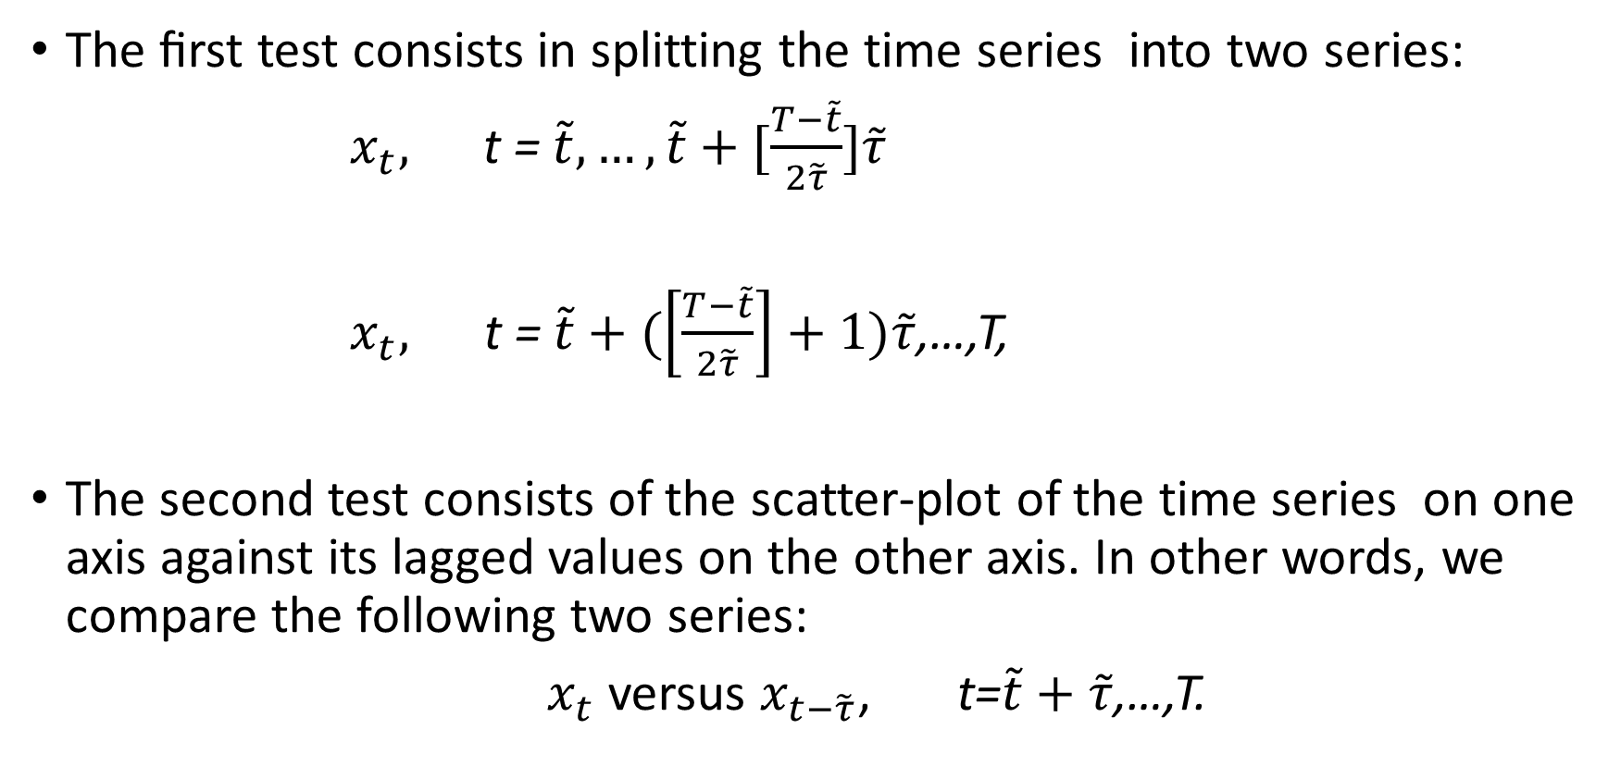
two simple graphical tests
The ﬁrst test consists in splitting the time series into two series:
${ x}_{t},$ t = $\tilde{t},…,\tilde{t}+[\frac{T−\tilde{t}}{2\tilde{τ}}]\tilde{τ}$
$x_{t},$ t = $\tilde{t}+(\left[\frac{T−\tilde{t}}{2\tilde{τ}}\right]+1)\tilde{τ}$,…,T,
The second test consists of the scatter-plot of the time series on one axis against its lagged values on the other axis. In other words, we compare the following two series:
$x_{t}$ versus $x_{t−\tilde{τ}}$, t=$\tilde{t}+\tilde{τ}$,…,T.

Slide 9
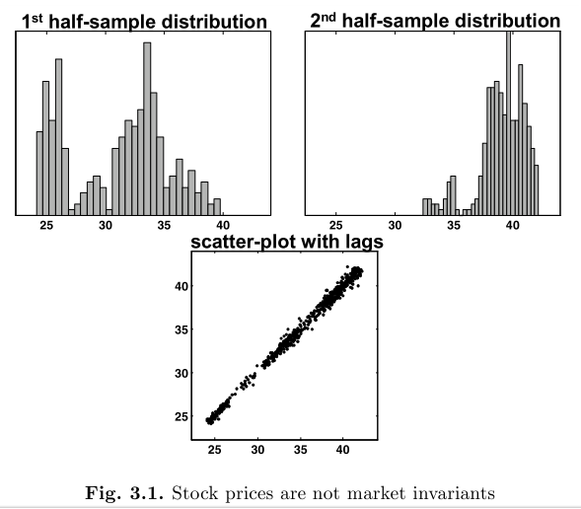
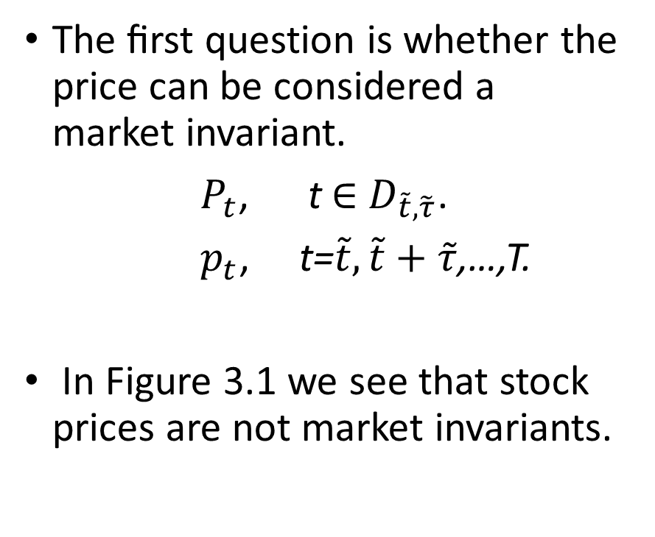
3.1.1 Equities, commodities, exchange rates
The ﬁrst question is whether the price can be considered a market invariant.
$P_{t}$, t$∈$ $D_{\tilde{t},\tilde{τ}}$.
$p_{t}$, t=$\tilde{t},\tilde{t}+\tilde{τ}$,…,T.
In Figure 3.1 we see that stock prices are not market invariants.

Slide 10
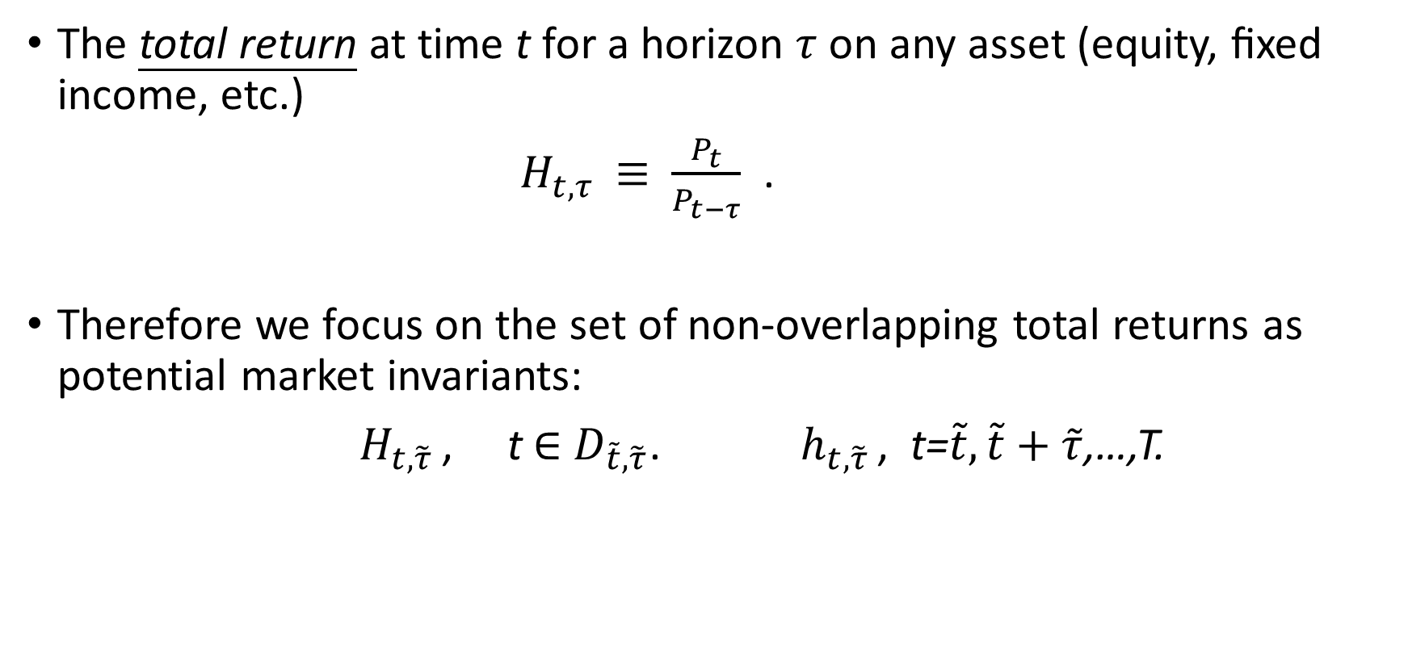
The total return at time t for a horizon $τ$ on any asset (equity, ﬁxed income, etc.)
$H_{t,τ }≡$ $\frac{P_{t}}{P_{t−τ}}$ .
Therefore we focus on the set of non-overlapping total returns as potential market invariants:
$H_{t,\tilde{τ} }$, t$∈$ $D_{\tilde{t},\tilde{τ}}$. $h_{t,\tilde{τ} }$, t=$\tilde{t},\tilde{t}+\tilde{τ}$,…,T.

Slide 11
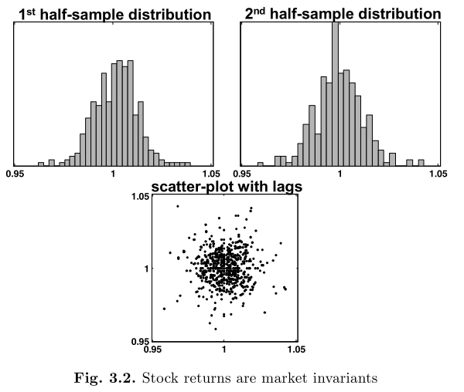
Therefore we accept the set of non-overlapping total returns as invariants for the equity market.

Slide 12
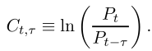
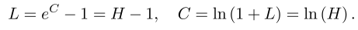
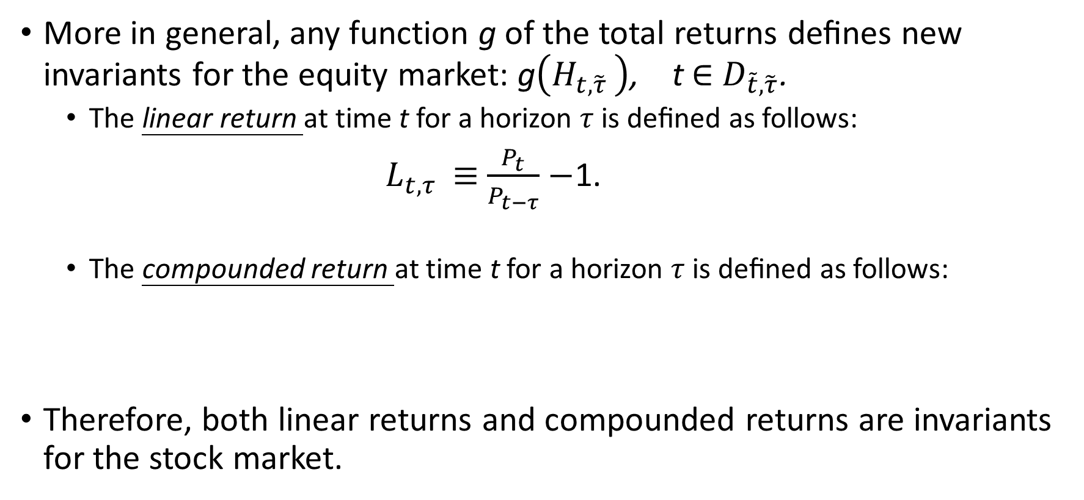
More in general, any function g of the total returns deﬁnes new invariants for the equity market: g$\left(H_{t,\tilde{τ} }\right)$, t$∈$ $D_{\tilde{t},\tilde{τ}}$.
The linear return at time t for a horizon $τ$ is deﬁned as follows:
$L_{t,τ }≡$ $\frac{P_{t}}{P_{t−τ}}−$1.
The compounded return at time t for a horizon $τ$ is deﬁned as follows:
Therefore, both linear returns and compounded returns are invariants for the stock market.

Slide 13
We claim that the most convenient representation of the invariants for the stock market is provided by the compounded returns
In the ﬁrst place, unlike for linear returns or total returns, the distribution of the compounded returns can be easily projected to any horizon, see Section 3.2, and then translated back into the distribution of market prices at the speciﬁed horizon, see Section 3.3.
Secondly, the distribution of either linear returns or total returns is not symmetrical. Instead, compounded returns have an approximately symmetrical distribution. This makes it easier to model the distribution of the compounded returns.

Slide 14
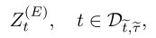
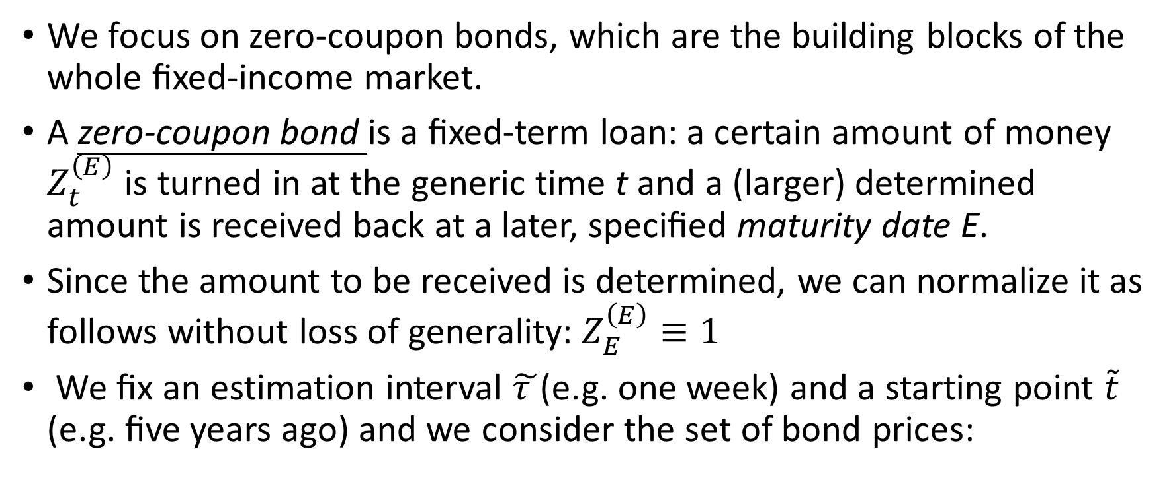
3.1.2 Fixed-income market
We focus on zero-coupon bonds, which are the building blocks of the whole ﬁxed-income market.
A zero-coupon bond is a ﬁxed-term loan: a certain amount of money $Z_{t}^{\left(E\right)}$ is turned in at the generic time t and a (larger) determined amount is received back at a later, speciﬁed maturity date E.
Since the amount to be received is determined, we can normalize it as follows without loss of generality:$Z_{E}^{\left(E\right)}$ $≡1$
We ﬁx an estimation interval $\tilde{τ }$(e.g. one week) and a starting point $\tilde{t}$ (e.g. ﬁve years ago) and we consider the set of bond prices:

Slide 15
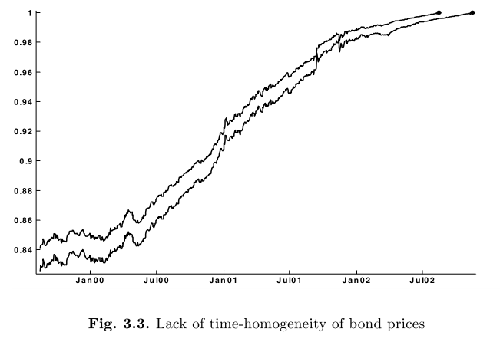
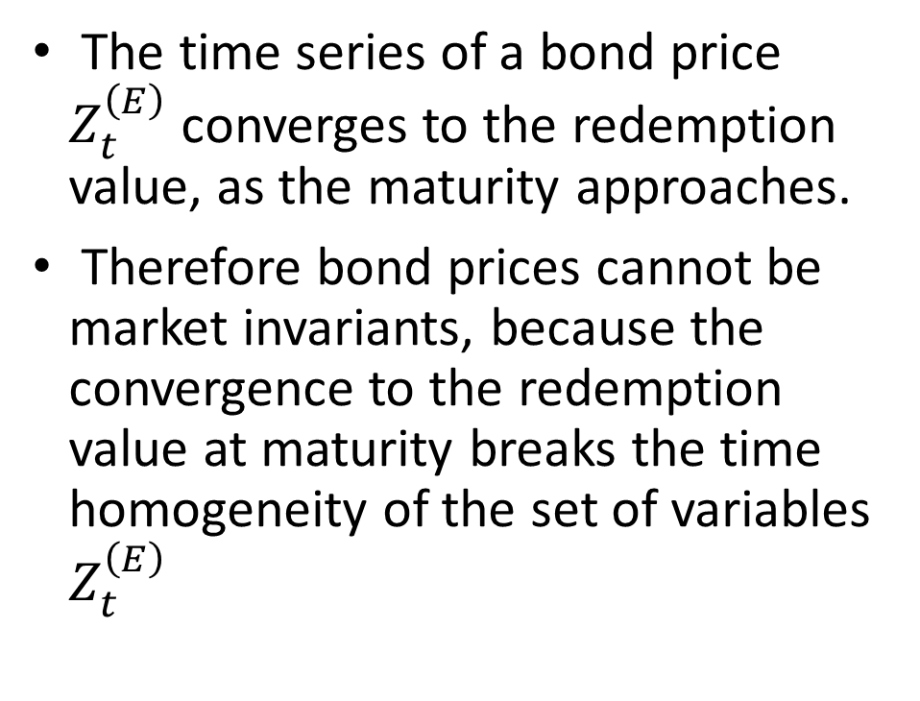
The time series of a bond price $Z_{t}^{\left(E\right)}$ converges to the redemption value, as the maturity approaches.
Therefore bond prices cannot be market invariants, because the convergence to the redemption value at maturity breaks the time homogeneity of the set of variables $Z_{t}^{\left(E\right)}$

Slide 16
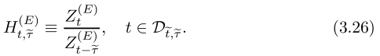
Consider the set of non-overlapping total returns on the generic bond whose time of maturity is E:
Nevertheless, the total returns cannot be invariants, because the convergence to the redemption value of the prices also breaks the time homogeneity of the set of variables (3.26).
為了找到invariant，我們必須解決到期日會破壞time homogeneity的問題。假設存在所有可能到期日的zero-coupon bond，那我們可以去比較相同時間到期的債券。

Slide 17
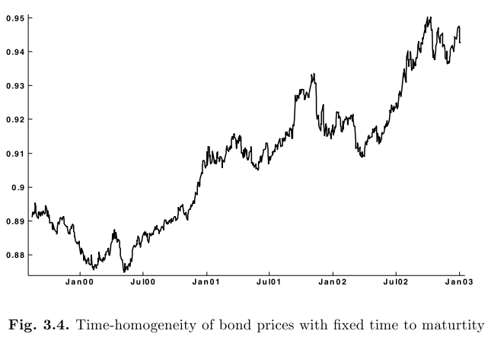
這張圖呈現在時間序列下的各個點畫上到期日皆為五年的債券價格，很明顯看到這樣的序列就會是 time-homogeneous

Slide 18
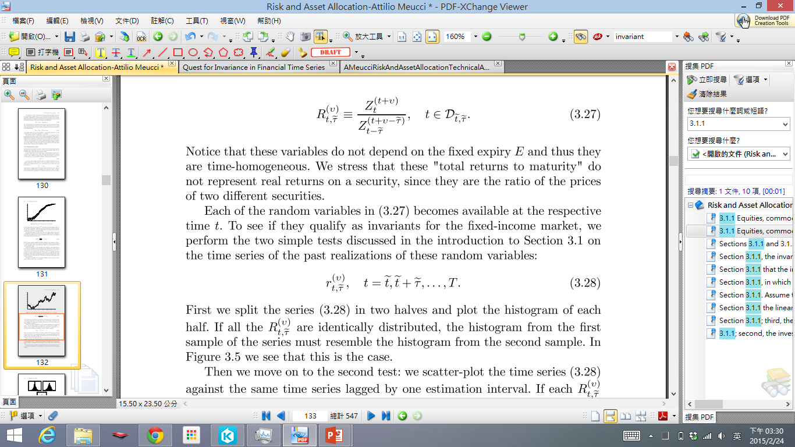
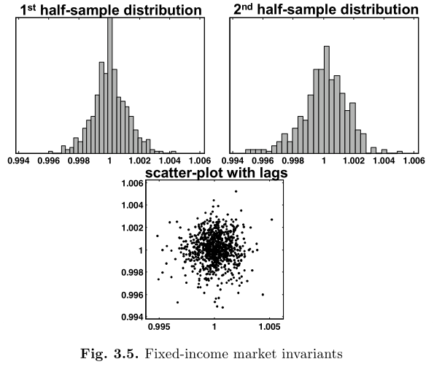
Consider the set of non-overlapping "total returns" on bond prices with the same time v to maturity:
要注意的是這些“total returns to maturity”
並不是代表真的報酬率，因為這個比率
的價格是兩個不同的債券。

Slide 19
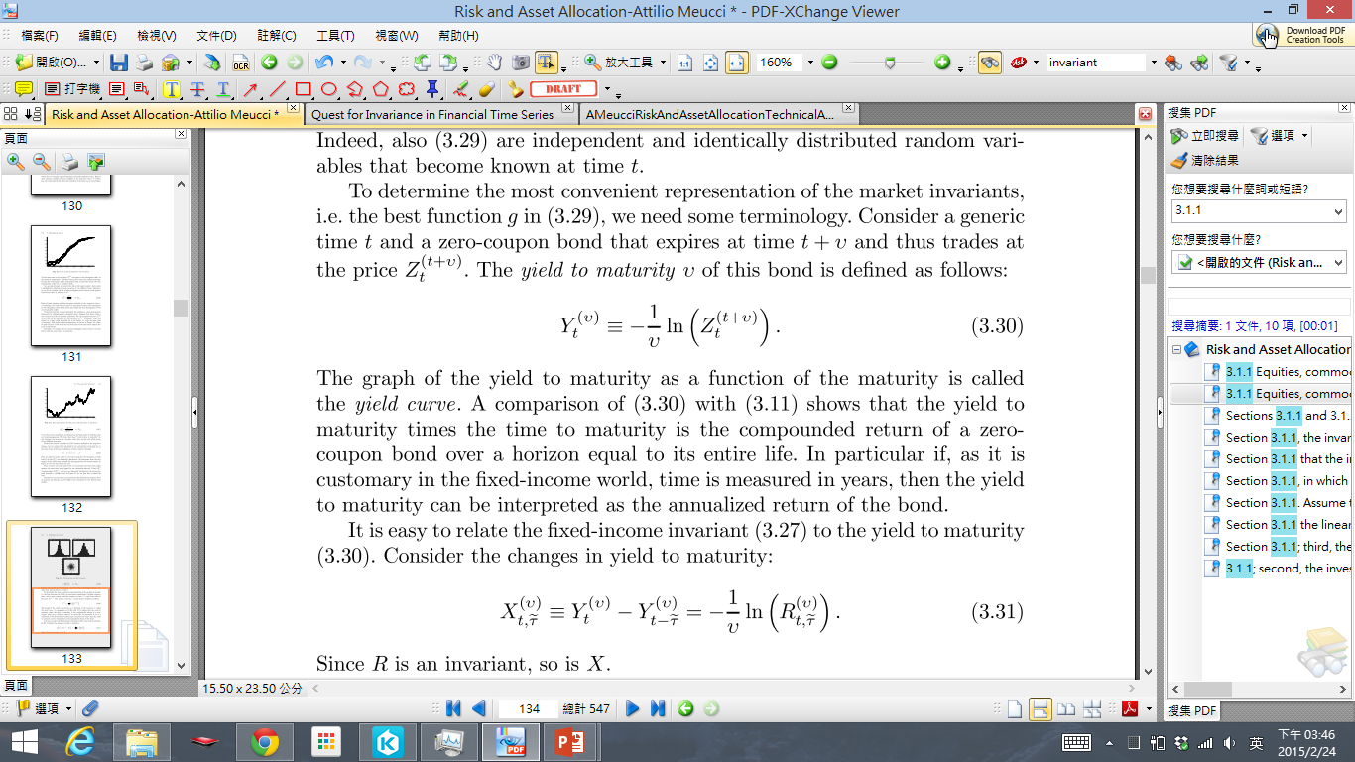
The yield to maturity v of this bond is deﬁned as follows:
Consider the changes in yield to maturity:
Since R is an invariant, so is X
ﬁxed-income invariants: changes in yield to maturity
比較簡單投影到其他任何的horizon
分布是對稱的，對於建構分布來說比較簡單

